Slide 1
EXPLORATORY DATA ANALYSIS
Uber Fare Prediction Project
Which factors actually drive the fare — and which only look like they do
Omar ElDawy
ML Engineer Intern — Cellula Technologies
Task 1 · Week 1
github.com/omarnasr9975/Cellula-Task-1

Slide 2

Dataset Overview & Cleaning
NYC Uber ride records — from raw export to analysis-ready data
500,000
481,437
24
~3.7%
Raw rows loaded
Rows after cleaning
Final columns
Rows removed as invalid
Cleaning steps applied
Removed duplicate trips (via key) and non-useful ID columns
Dropped rows with nulls, negative fares, and zero passengers
Fixed coordinates & bearing: converted radians → degrees
Filtered pickups/dropoffs to real NYC geographic bounds
Removed physically impossible fare/distance combinations
Standardized column names; resolved a duplicated weekday column
Fare & distance snapshot
Metric | Fare Amount ($) | Distance (km)
Mean | 11.31 | 3.36
Median | 8.50 | 2.18
Max | 281.05 | 110.83
Cellula Technologies • Uber Fare Prediction — Task 1 EDA
2

Slide 3
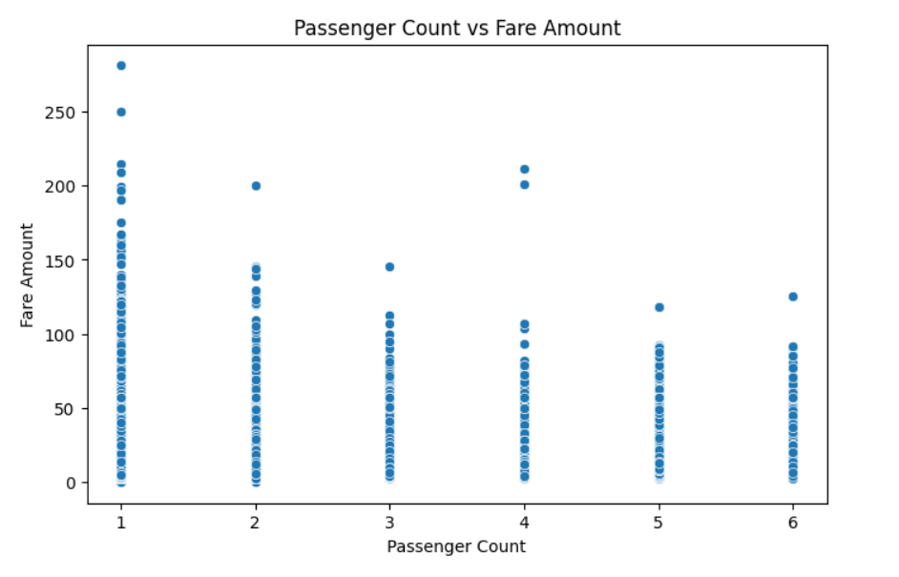
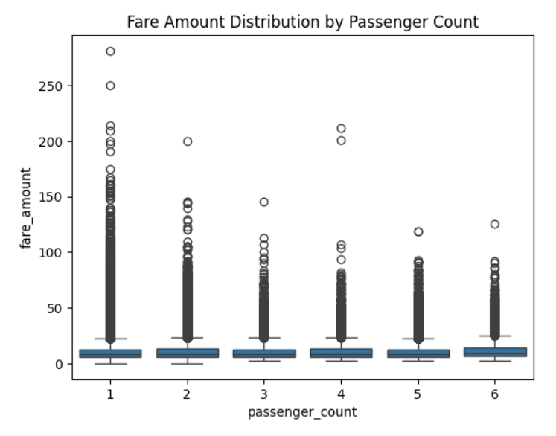
Does Passenger Count Affect Fare?
Variables: passenger_count (discrete) vs fare_amount — a lesson in misleading visuals
Initial scatter
Corrected boxplot
Insight: The scatter suggested passenger_count=1 rides had higher fares — but that group has 334K rides vs. just 10K for count=4. Comparing true averages shows fares are nearly flat ($11.16–$12.37) across all group sizes. Passenger count has no real effect on fare.
Cellula Technologies • Uber Fare Prediction — Task 1 EDA
3

Slide 4
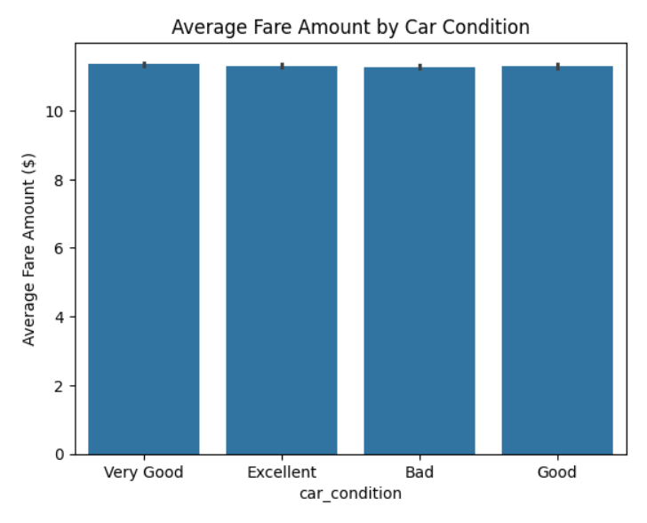
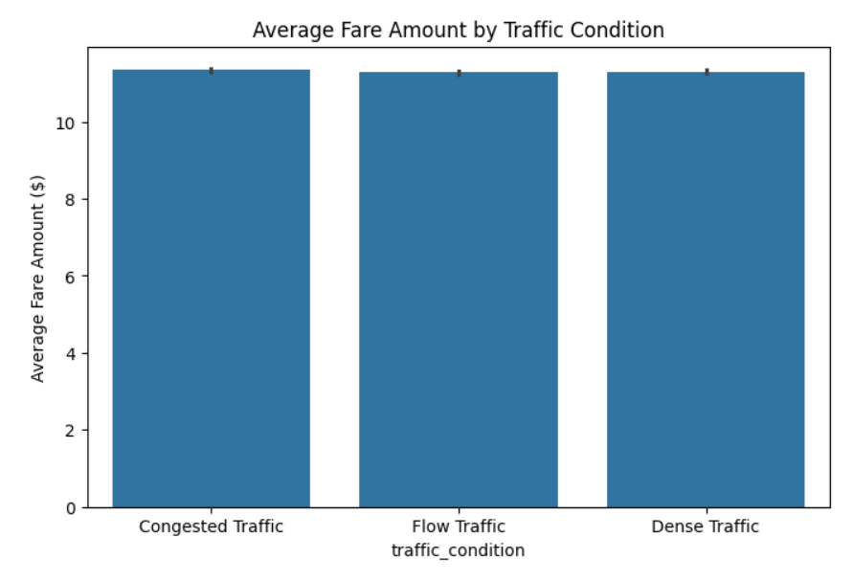
Car Condition & Traffic: Do They Change the Price?
Variables: car_condition / traffic_condition (categorical) vs fare_amount
Insight: Car condition (≈11.28–$11.35) and traffic level (≈11.28–$11.34) both show essentially flat average fares across every category, with balanced sample sizes (~120K and ~160K rides per group). Neither vehicle condition nor traffic congestion affects what riders pay.
Cellula Technologies • Uber Fare Prediction — Task 1 EDA
4

Slide 5
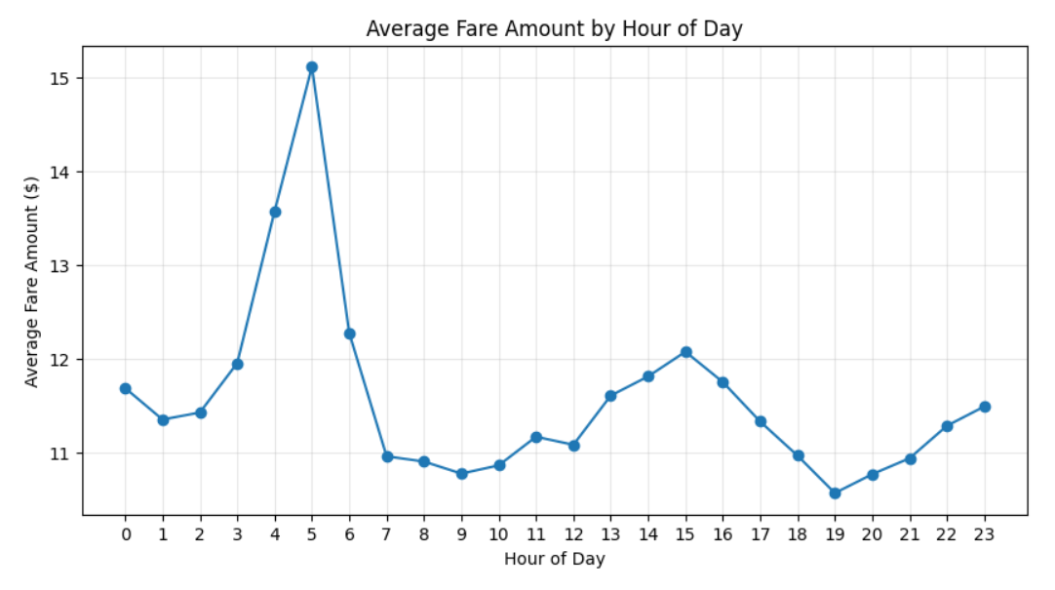
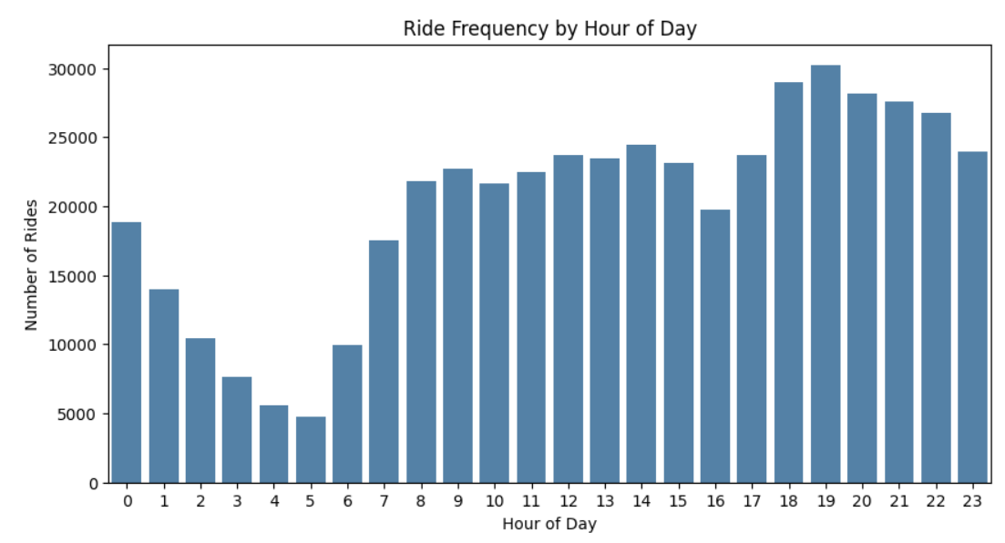
Fare and Demand by Hour of Day
Variables: hour (ordered) vs fare_amount, and ride frequency by hour
Insight: Fare peaks at 5AM (~$15.1) while ride demand is at its lowest that hour (~5K rides). Demand actually peaks in the evening (6–10PM, ~30K rides/hr) when fares are near their lowest. Fare and demand move in opposite directions — this rules out surge pricing; the 5AM peak reflects longer average trip distance, not higher demand.
Cellula Technologies • Uber Fare Prediction — Task 1 EDA
5

Slide 6
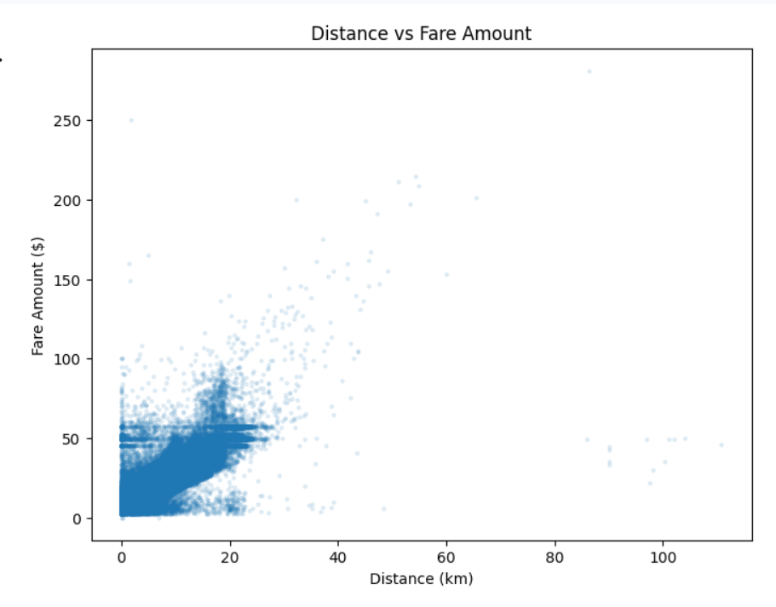

THE ANCHOR FINDING
Distance Is the Real Driver of Fare
r = 0.85
correlation with fare — the strongest of any variable tested
Fare rises consistently as distance increases
Explains why passengers, car condition, traffic and hour all appeared to matter
Every one of those was really a proxy for distance
Cellula Technologies • Uber Fare Prediction — Task 1 EDA
6

Slide 7
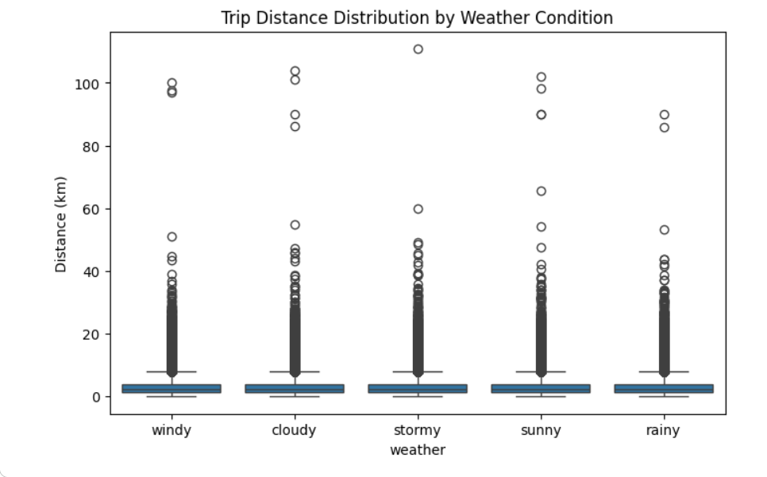
Does Weather Change How Far People Travel?
Variables: weather (categorical) vs distance
Insight: Average trip distance is nearly identical across all 5 weather conditions (3.36–3.37 km, medians 2.18–2.19 km). Weather has no meaningful effect on how far people travel.
Cellula Technologies • Uber Fare Prediction — Task 1 EDA
7

Slide 8
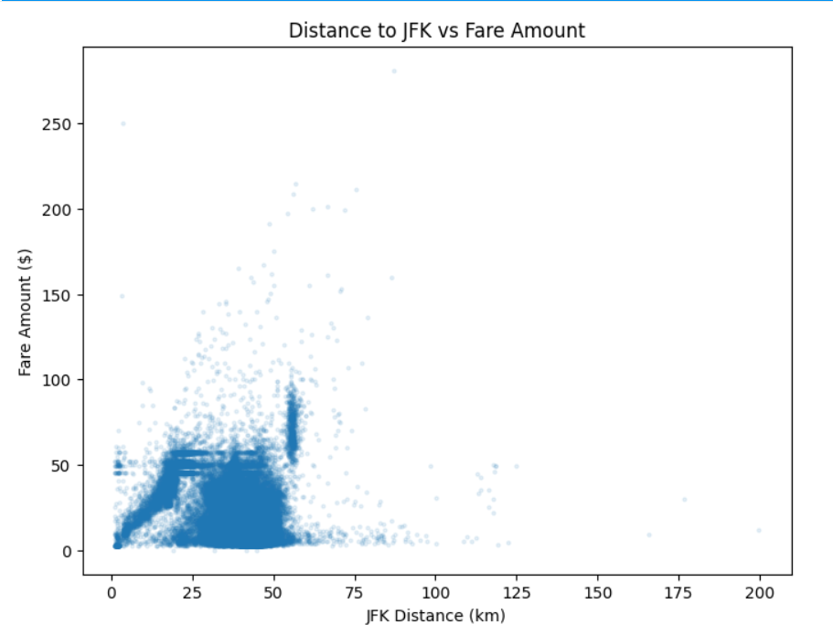

Are Airport Trips More Expensive?
Variables: jfk_dist / ewr_dist / lga_dist vs fare_amount
Airport-area trips (< 2km) vs. all other trips
Airport | Avg Fare | Other Trips | n
JFK | $14.61 | $11.31 | 127
LGA | $8.79 | $11.31 | 112
EWR | $61.50* | $11.31 | 3*
*EWR sample too small (n=3) to be reliable
Why the raw correlation misleads
JFK correlation is negative (-0.47) — dominated by 481K short, unrelated city trips
LGA is closer to Manhattan → shorter trips → lower fares
JFK distance vs fare — raw correlation is misleading
Only isolating true airport pickups reveals the real premium
Cellula Technologies • Uber Fare Prediction — Task 1 EDA
8

Slide 9
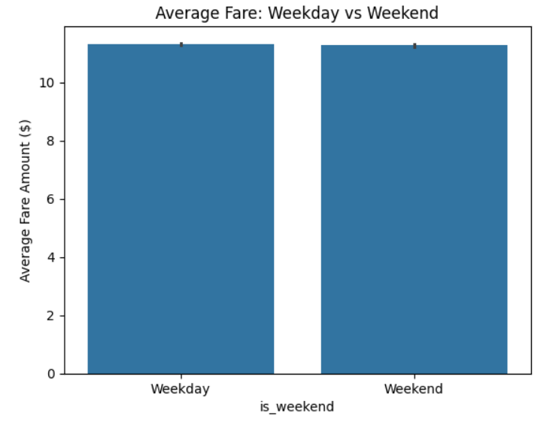
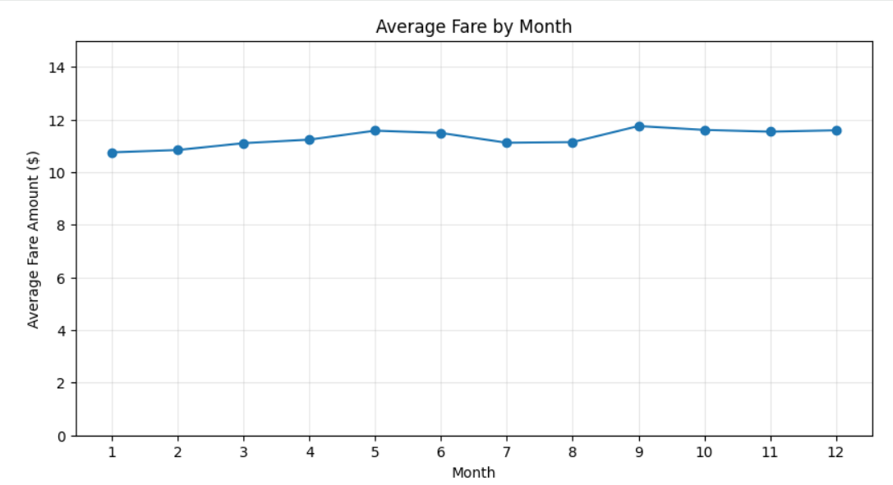
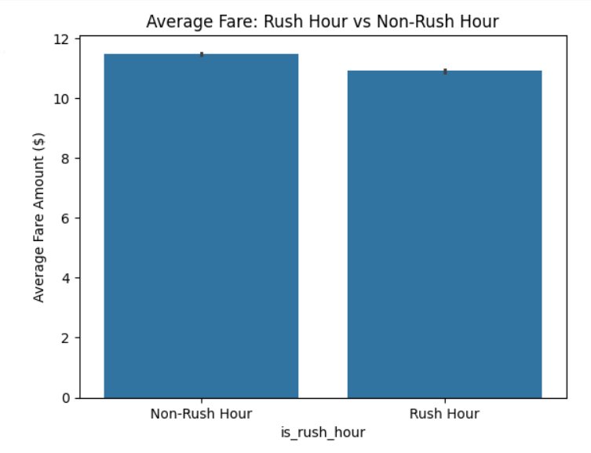
More Factors Tested — Still No Effect
Weekend, month, and rush hour all trace back to the same conclusion
Weekday vs Weekend: $11.32 vs $11.27 — flat
Month: fares hover near $11 all year — flat once viewed on a true scale
Rush Hour vs Non-Rush Hour: $10.90 vs $11.49 — the small gap is explained by shorter rush-hour trips (3.12 vs 3.47 km), not timing itself
Cellula Technologies • Uber Fare Prediction — Task 1 EDA
9

Slide 10
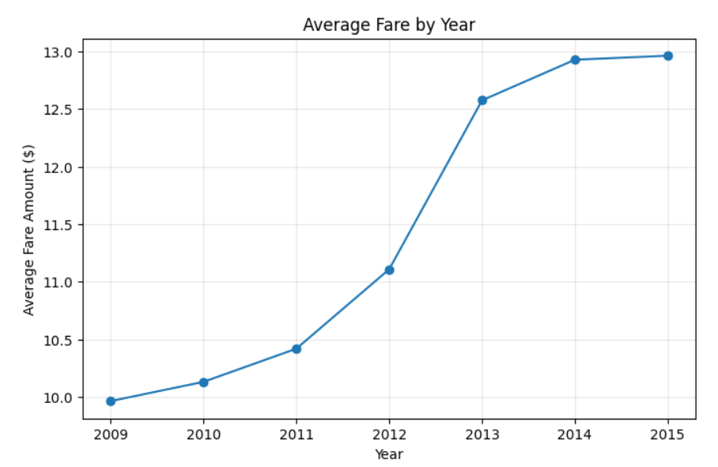
A GENUINE TIME-BASED EFFECT
Fares Genuinely Rose Over Time
+30%
fare increase from 2009 ($9.96) to 2015 ($12.96)
Distance rose only ~7% over the same years — too small to explain the jump
The only pattern in this analysis that isn't a distance effect in disguise
Most likely reflects inflation or fare-rate changes over time
Cellula Technologies • Uber Fare Prediction — Task 1 EDA
10

Slide 11
Key Takeaways
What this EDA means for Task 2 (modeling)
Distance is the dominant driver of fare (r = 0.85) — the single most important feature for modeling.
Passenger count, car condition, traffic, weather, weekday/weekend, rush hour, and month all show no real effect once distance is accounted for.
Genuine airport-area trips (JFK) do cost more — but only once isolated from the misleading overall correlation.
Fares rose ~30% from 2009–2015 — a real trend not explained by distance, likely inflation or rate changes.
Core lesson: always test whether an apparent pattern is real, or just a proxy for a stronger underlying variable.
Cellula Technologies • Uber Fare Prediction — Task 1 EDA
11

